Slide 1

Department of Information Technology
A.P. Shah Institute of Technology
G.B.Road, Kasarvadavli, Thane(W), Mumbai-400615
UNIVERSITY OF MUMBAI
Academic Year 2019-2020

Slide 2
A Project Report on
Title of your project
Submitted in partial fulfillment of the degree of
Bachelor of Engineering(Sem-7)
in
INFORMATION TECHNOLOGY
By
Sameer Dev (16104030)
Yogendra Kokamkar (16104016)
Sudama Jaiswal (16104015)
Under the Guidance of
Prof. Kiran B. Deshpande Prof. Kaushiki Upadhyaya

Slide 3
1.Project Conception and Initiation
Voice Based Smart Assistive Device for the Visually Challenged

Slide 4
1.1 Abstract
The World Health Organization (WHO) Fact reported that there are 285 million visually-impaired people worldwide. Among these individuals, there are 39 million who are blind in the world. Unfortunately, all these numbers are estimated to be doubled by 2020.
In this high tech era, technology has made it possible for everyone to live a comfortable life. But somehow the physically challenged people need to depend upon others in their daily life which ultimately makes them less confident in an unfamiliar environment.
So, in this project, an intelligent device is represented, which is an amalgamation of various technologies, for the visually challenged people to help them travel around the college and similar premises safely without facing any difficulties and needing human help.

Slide 5
1.2 Objectives
Build a device for travelling safely around the campus
Overcome Environmental Challenges
Overcome Technological Challenges
Overcome Social Challenges

Slide 6
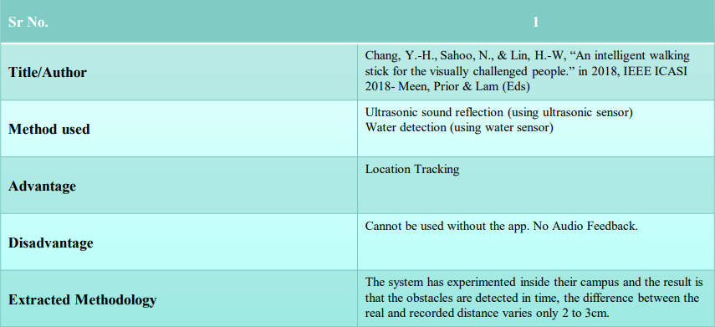
1.3 Literature Review

Slide 7
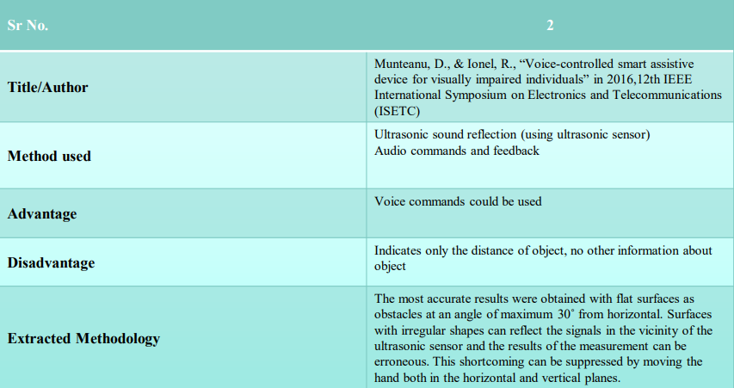
1.3 Literature Review

Slide 8
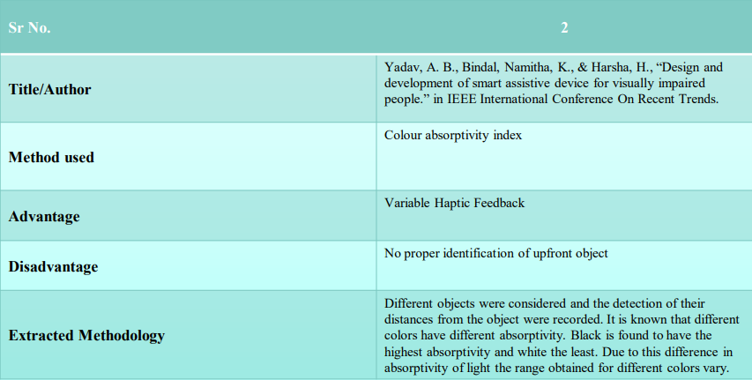
1.3 Literature Review

Slide 9
1.4 Problem Definition
To create an assistive device for visually impaired people which will let them get a better sense of the surroundings and environment of our college and similar premises and also give them audio feedback regarding the obstacles. The device can also classify the nearby objects and give a basic idea to the user about the object either by voice commands. The device can be fully operated by voice commands for easy usage.

Slide 10
1.5 Scope
The device will make the use of various technologies in order to create a single device capable of assisting the huge number of people in need.
The device will be making real time predictions without any human help, it will be an added benefit as the people using this device will be able to walk around the campus without any external human help

Slide 11
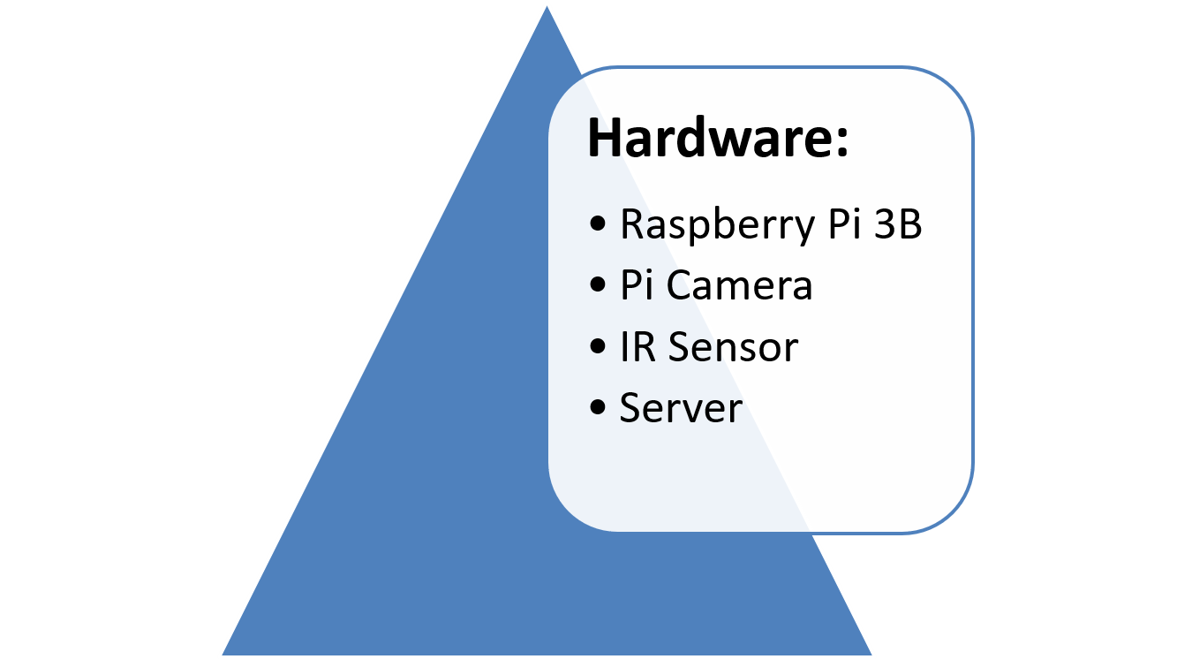
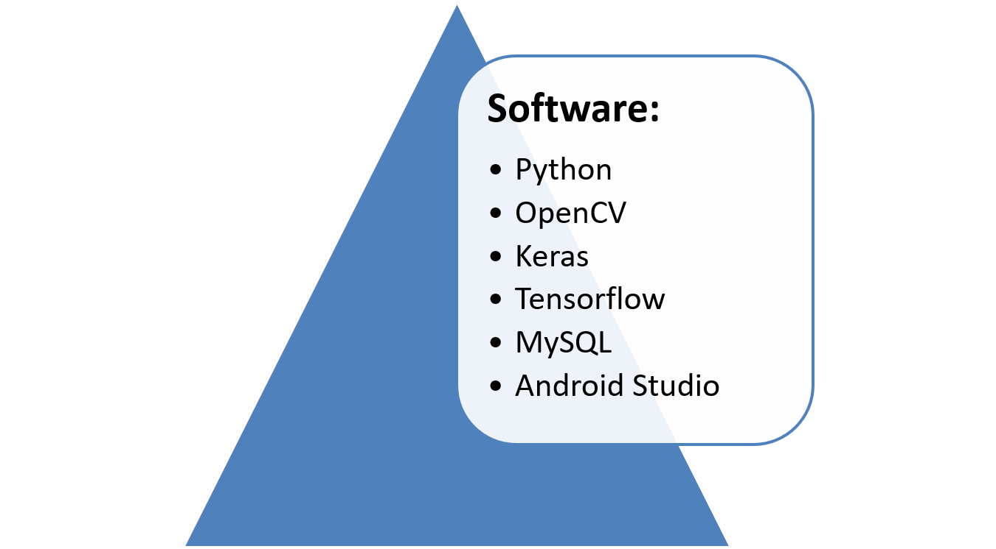
1.6 Technology stack

Slide 12
1.7 Benefits for environment & Society
The device will make the use of various technologies in order to create a single device capable of assisting the huge number of people in need.
The device will be making real time predictions without any human help, it will be an added benefit as the people using this device will be able to walk around the campus without any external human help

Slide 13
2. Project Design

Slide 14
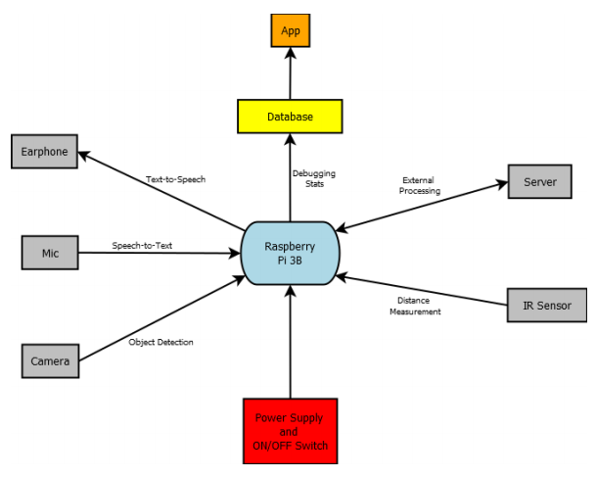
2.1 Proposed System

Slide 15
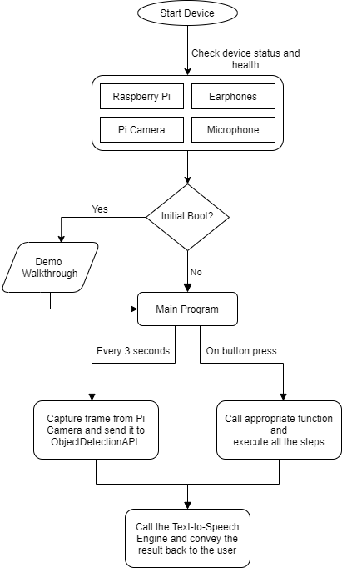
2.2 Design(Flow Of Modules)

Slide 16
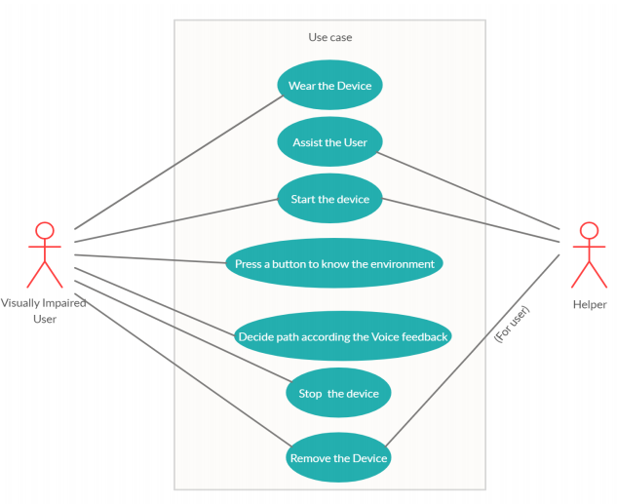
2.3 Description Of Use Case

Slide 17
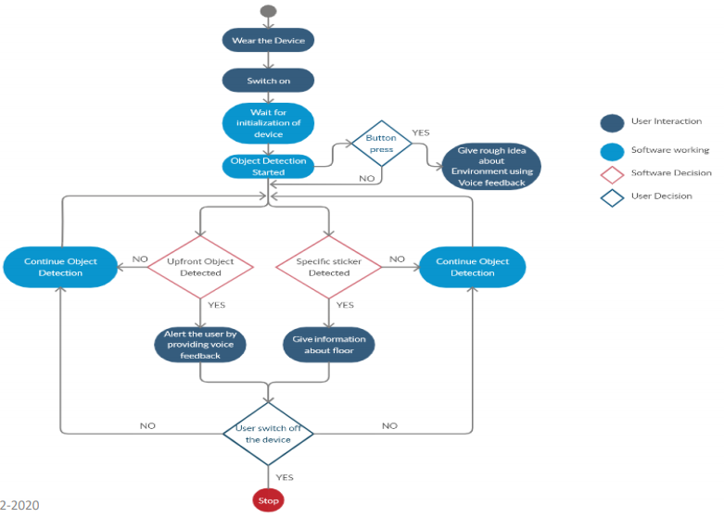
2.4 Activity diagram

Slide 18
2.6 Camera Module
The camera module, with the help of the Object Detection model running on the server, will continuously try to detect obstacles in the user’s path and on successfully detecting one it will generate a sentence that is now to be conveyed to the user after which the Text-to-Speech Engine will convey the information to the user in an audio format.

Slide 19
Environment Description Module
A dedicated button will be present which when pressed will trigger the camera module to capture the current frame and send it to the Environment Description Module, running on the server, which will generate a description of the frame and send it back to the Raspberry Pi which will in turn convey it to the user using the Text-to-Speech Engine.

Slide 20
Voice Recognition Module
There will also be another button to start the Voice Recognition module. It will listen for a period of 5 seconds and if it is unable to capture any voice or command then the mic will be shut and the rest of the program will continue its normal execution. The captured text will then be sent to Dialogflow via REST APIs, where we already have an agent running, for intent recognition. Based on the output of Dialogflow we then understand what the request of the user is and give the appropriate output for any given query.

Slide 21
2.7 References
[1] Chang, Y.-H., Sahoo, N., & Lin, H.-W. (2018). An intelligent walking stick for the visually challenged people. 2018 IEEE International Conference on Applied System Invention (ICASI)
[2] Yadav, A. B., Bindal, L., Namhakumar, V. U., Namitha, K., & Harsha, H. (2016). Design and development of smart assistive device for visually impaired people. 2016 IEEE International Conference on Recent Trends in Electronics, Information & Communication Technology (RTEICT)
[3] Munteanu, D., & Ionel, R. (2016). Voice-controlled smart assistive device for visually impaired individuals. 2016 12th IEEE International Symposium on Electronics and Telecommunications (ISETC)
[4] Agarwal, R., Ladha, N., Agarwal, M., Majee, K. K., Das, A., Kumar, S., Saha, H. N. (2017). Low cost ultrasonic smart glasses for blind. 2017 8th IEEE Annual Information Technology, Electronics and Mobile Communication Conference (IEMCON)
[5] Lee, C.-N., Chu, Y.-T., Cheng, L., Lin, Y.-T., & Lan, K.-F. (2017). Blind assistive device - Smart Lazy Susan. 2017 International Conference on Machine Learning and Cybernetics (ICMLC)

Slide 22
3. Future Additions

Slide 23
Planning
• The primary language currently is English but we can also add language support for Hindi and Marathi
• Implement this solution for areas other than our campus

Slide 24
Thank You

